Slide 1
Chapter 3
Cascading Style Sheets
Programming the World Wide Web
Fourth edition
By Robert W. Sebesta

Slide 2
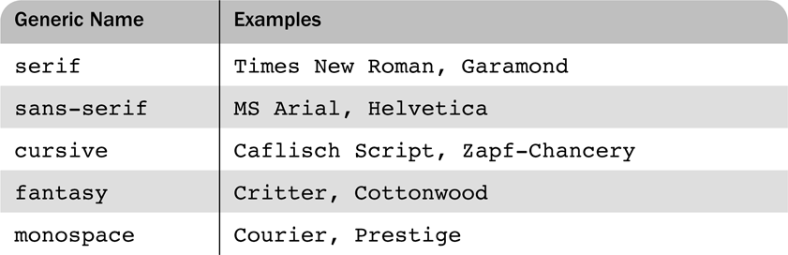
Table 3.1 Generic fonts

Slide 3

Figure 3.1 Display of fonts.html

Slide 4
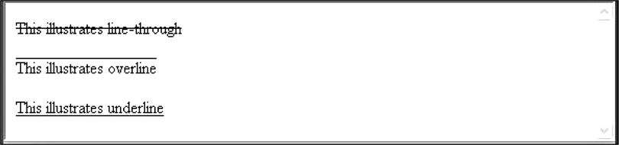
Figure 3.2 Display of decoration.html

Slide 5
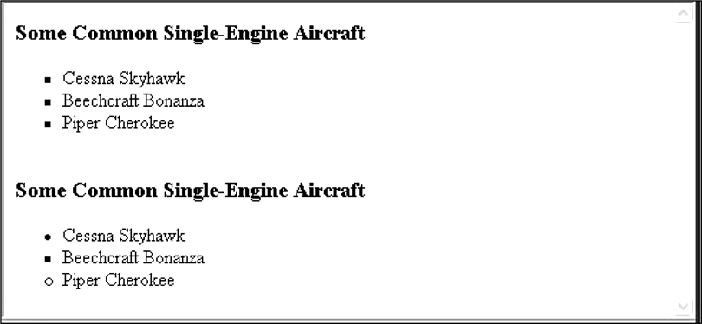
Figure 3.3 Examples of unordered lists

Slide 6
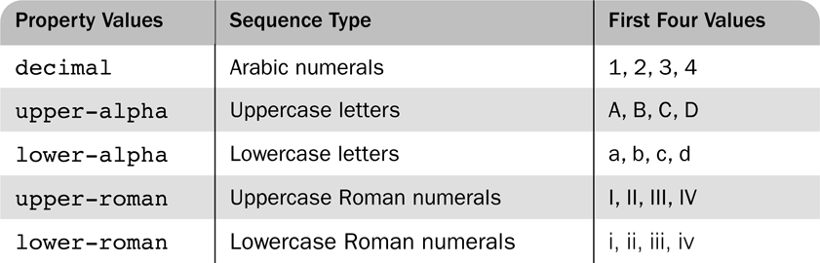
Table 3.2 Possible sequencing values for ordered lists

Slide 7
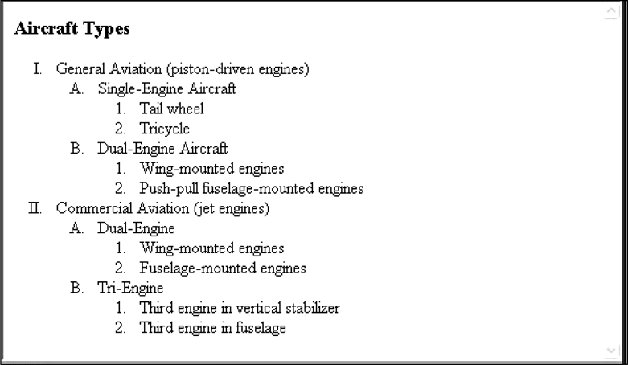
Figure 3.4 Display of sequence_types.html

Slide 8
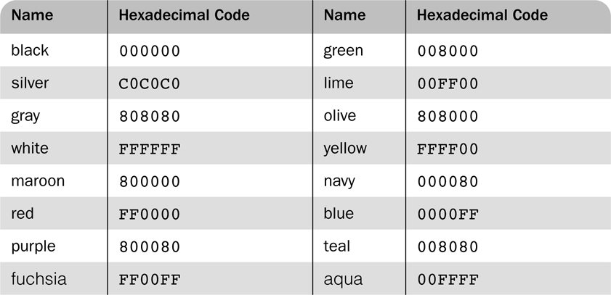
Table 3.3 Named colors

Slide 9
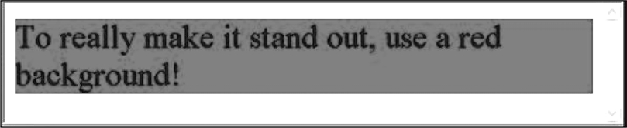
Figure 3.5 The background-color property

Slide 10
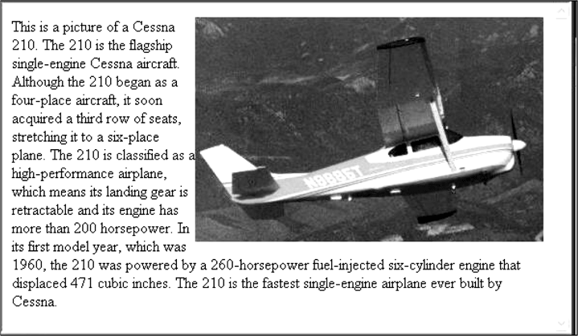
Figure 3.6 Display of float.html

Slide 11
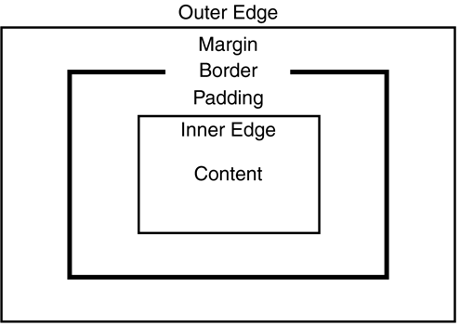
Figure 3.7 The box model

Slide 12
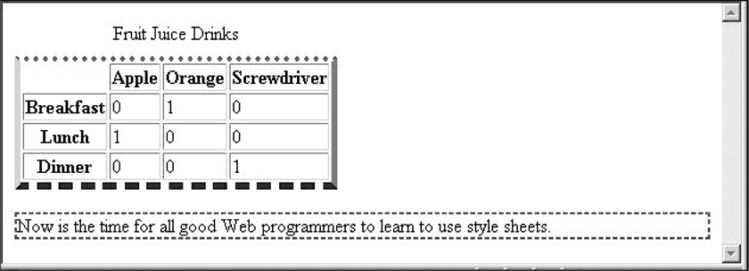
Figure 3.8 Borders

Slide 13
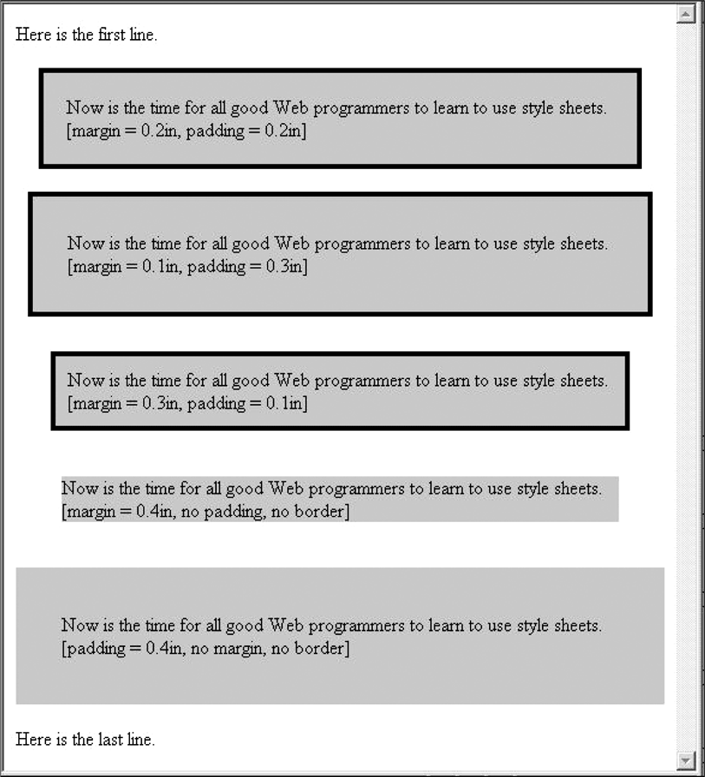
Figure 3.9 Display of marpads.html

Slide 14
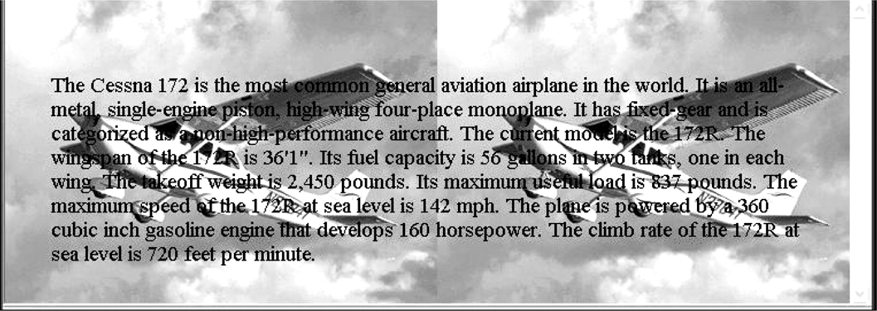
Figure 3.10 Display of back_image.html

Slide 15
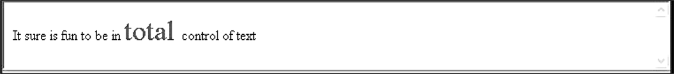
Figure 3.11 The <span> tag

